Slide 1



Journey To Your Best
CHALLENGE
0
Khuat Bao Nguyen

Slide 2
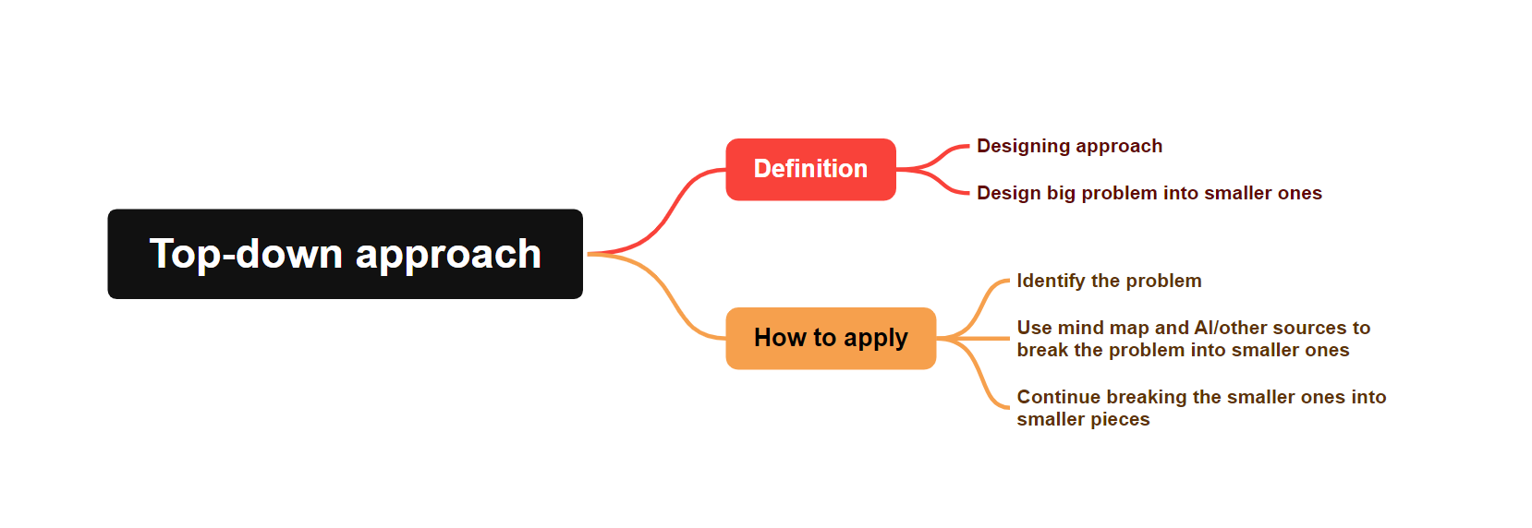
TOP DOWN APPROACH

Slide 3




HOW TO LEARN AND LEARN FAST
LEARN FROM THE OTHERS
LEARN BY EXPERIENCE
MAKE USE OF EVERY AVAILABLE RESOURCE

Slide 4
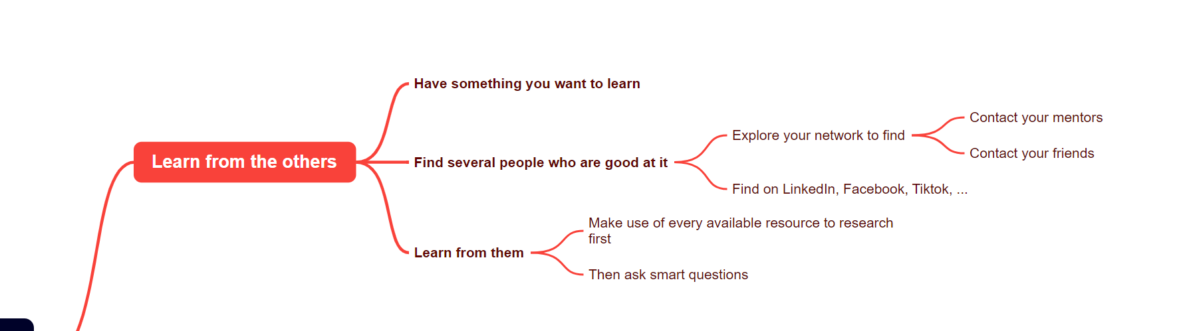
LEARN FROM THE OTHERS

Slide 5
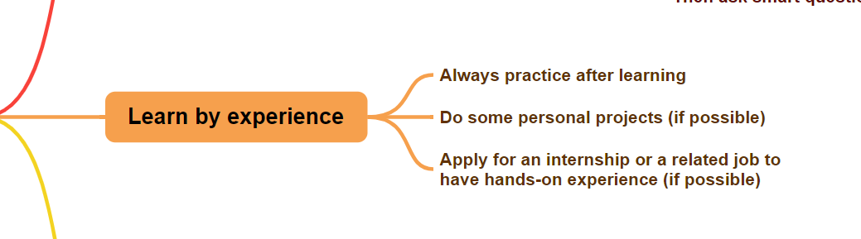
LEARN BY EXPERIENCE

Slide 6
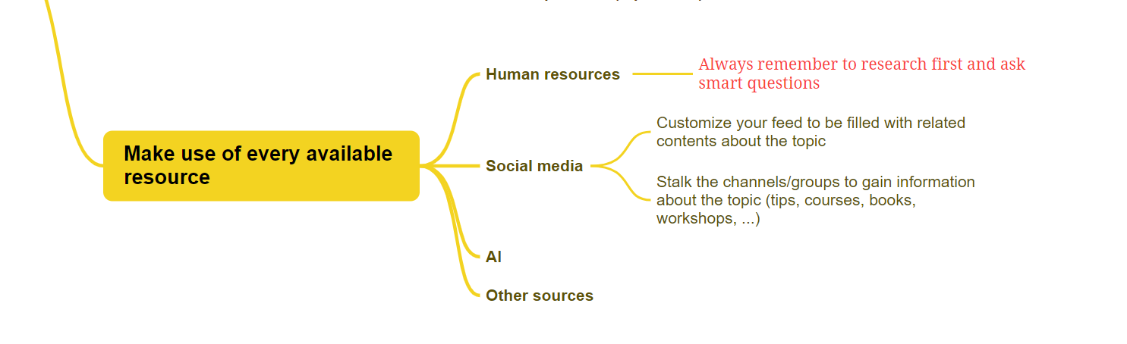
MAKE USE OF EVERY AVAILABLE RESOURCE

Slide 7

AUTONOMY AT
WORK
DEFINITION
1
Ownership but with boundaries and constraints, alignment -> Alignment enables autonomy
SIGNS OF AN AUTONOMOUS EMPLOYEE
2
WHY AUTONOMY AT WORK IS IMPORTANT
3

Slide 8
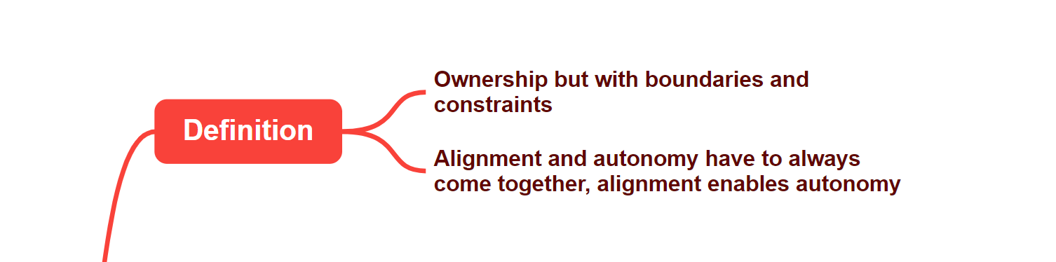
WHAT IS AUTONOMY AT WORK

Slide 9

SIGNS OF AN AUTONOMOUS EMPLOYEE
Accountability
Initiative
Respectful attitude
Continuous learning

Slide 10
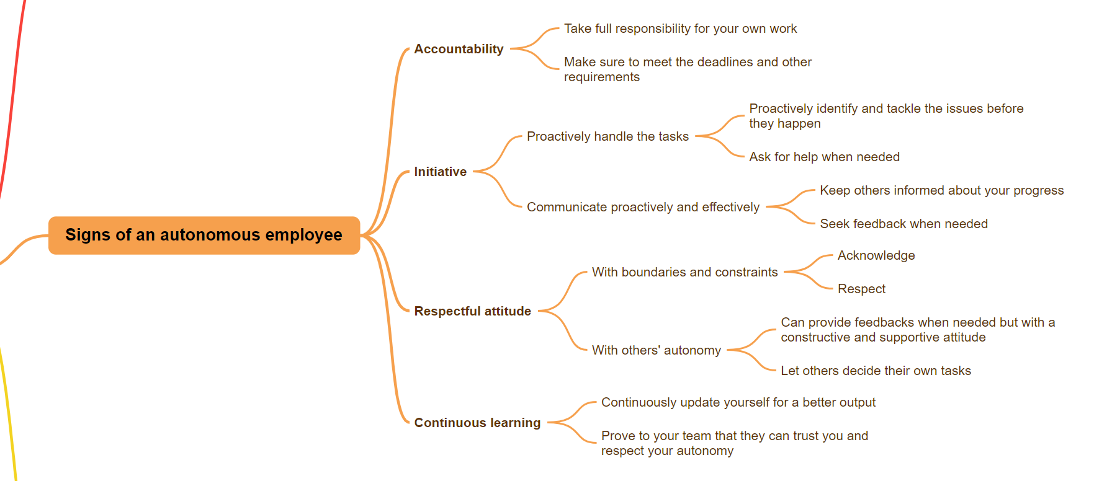

Slide 11
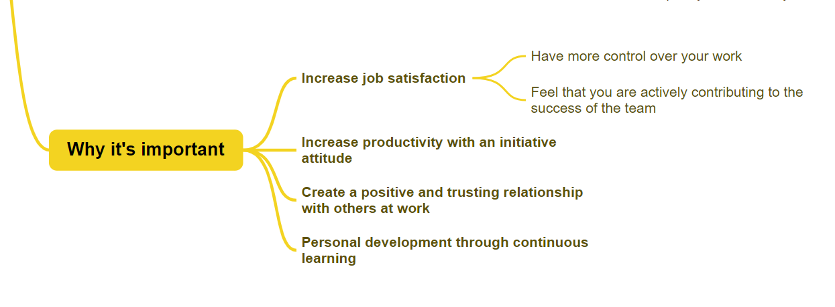
WHY AUTONOMY
AT WORK IS IMPORTANT

Slide 12
ASKING SMART QUESTIONS
WHAT MAKES A
SMART QUESTION
1
HOW TO APPLY SMART QUESTIONS
2

Slide 13

WHAT MAKES A SMART QUESTION
Open-endedness
Clarity
Comprehensiveness
Non-triviality
Critical thinking

Slide 14
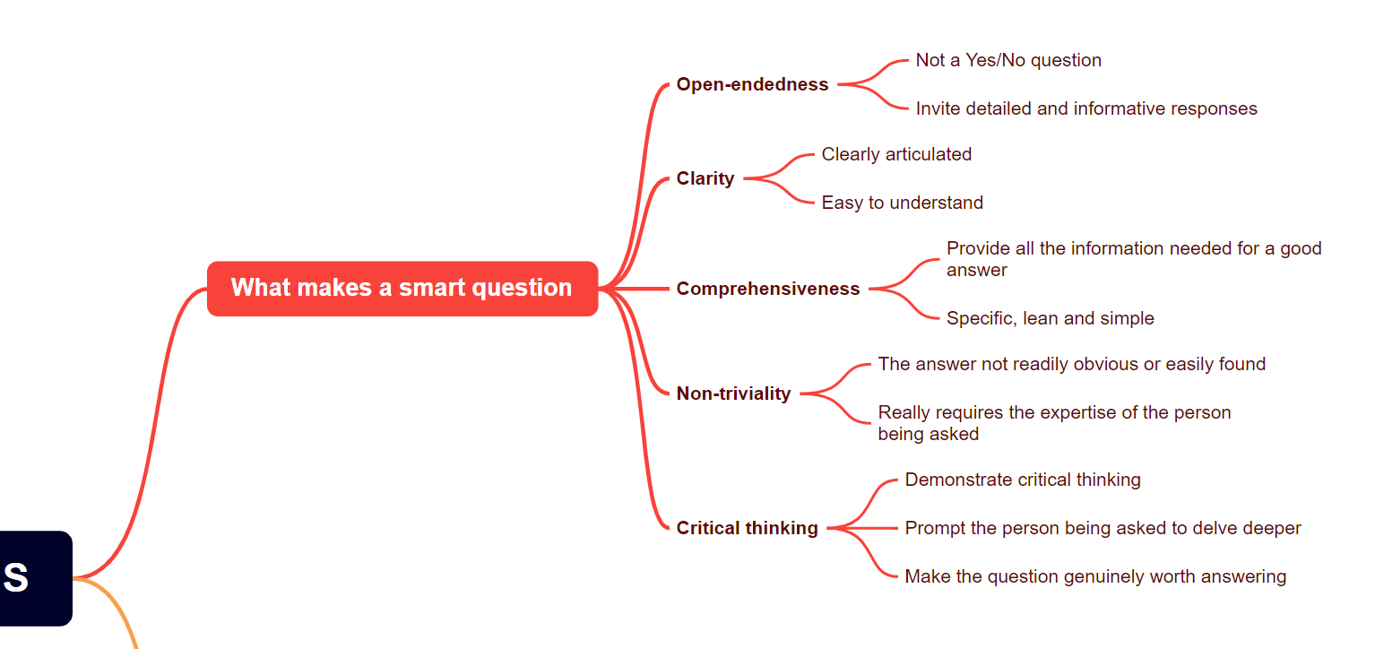

Slide 15
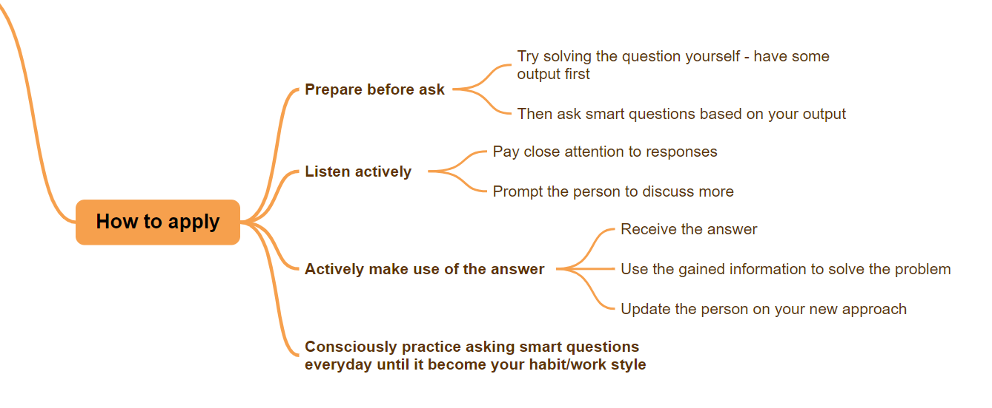
HOW TO APPLY SMART QUESTIONS

Slide 16
THANKS FOR READING
JOURNEY TO YOUR BEST
Khuat Bao Nguyen

